Slide 1

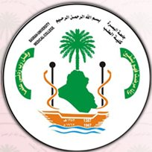

Extrapyramidal tracts
Dr. Massara Ghassan Abdulkareem
Physiology Department
College of Medicine\ University of Basrah
Notes:
jjkhjkhgjh

Slide 2
Objectives
Reticular formation.
Types of Reticular formation projections and their functions
Vestibulospinal tract nd its functions
Tectospinal tract
University of Basrah-College of Medicine-Physiology Department
1

Slide 3
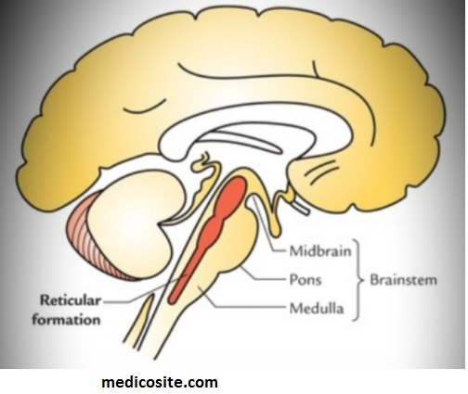
Reticular formation
It’s a set of interconnected nuclei that are located throughout the brainstem
The neurons of the reticular formation make up a complex set of networks in the core of the brainstem that extend from the upper part of the midbrain to the lower part of the medulla oblongata
University of Basrah-College of Medicine-Physiology Department
2

Slide 4
Reticulospinal tract
  Fibers arising from reticular formation end on different
  segments of the spinal cord in the gamma motor neuron
  Reticular formation consists of two parts:
  Facilitatory area (larger & upper)
  Capable of spontaneous discharge → maintains normal
  muscle tone
  2. Inhibitory area (smaller & caudal)
  Driven by fibers from inhibitory suppressor strips
  of cerebral cortex or fibers from basal ganglia
Tone: is muscles resistance to passive stretch at rest
University of Basrah-College of Medicine-Physiology Department
3

Slide 5
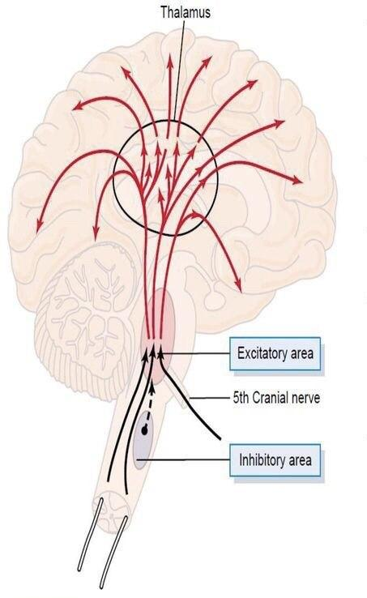
University of Basrah-College of Medicine-Physiology Department
4

Slide 6
Muscle tone is maintained by facilitatory and inhibitory reticular formation.
Reticular formation is controlled by cerebral cortex and basal ganglia
Damage to extrapyramidal fibers from cerebral cortex or basal ganglia → inhibitory influence to reticular formation is lost (facilitaory area can discharge spontaneously) → hypertonia
University of Basrah-College of Medicine-Physiology Department
5

Slide 7
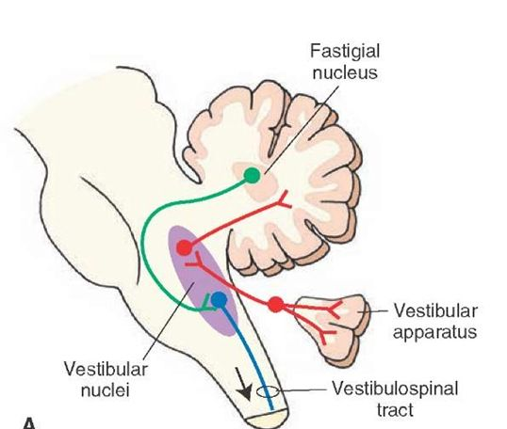
  Vestibulospinal tract
  Vestibular nucleus receives connections from inner ear, cerebellum, basal ganglia, cerebral cortex, reticular formation etc.
University of Basrah-College of Medicine-Physiology Department
6

Slide 8
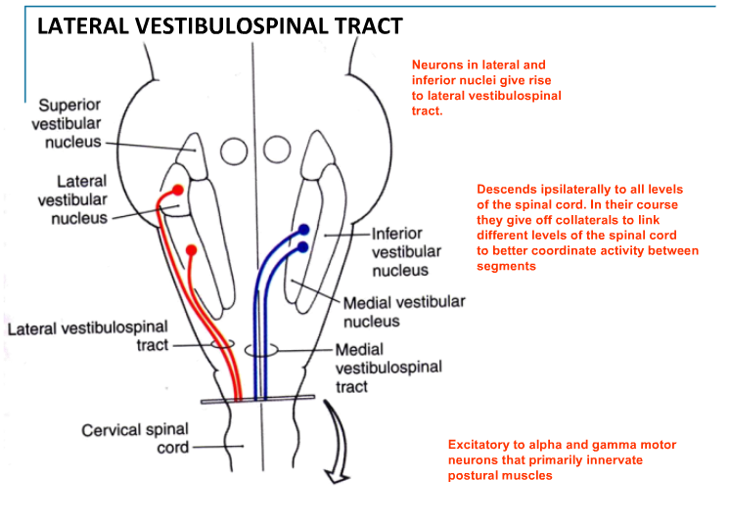
  Lateral vestibulospinal tract
  *From lateral and inferior vestibular nucleus
  Medial vestibulospinal tract
  *From medial vestibular nucleus
University of Basrah-College of Medicine-Physiology Department
7

Slide 9
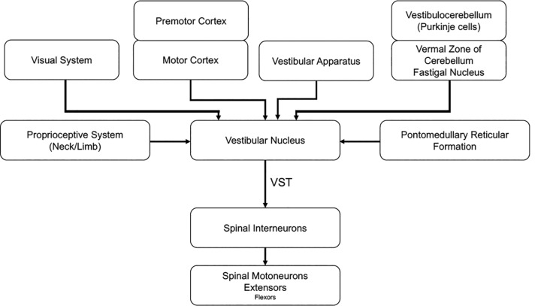
University of Basrah-College of Medicine-Physiology Department
8

Slide 10
Functions of Vestibulospinal tract
The vestibulospinal tract is for
maintenance of balance.
regulation of the muscle tone related to posture.
respond correctly by recording sensory information from hairs cells in the labyrinth of the inner ear.
University of Basrah-College of Medicine-Physiology Department
9

Slide 11
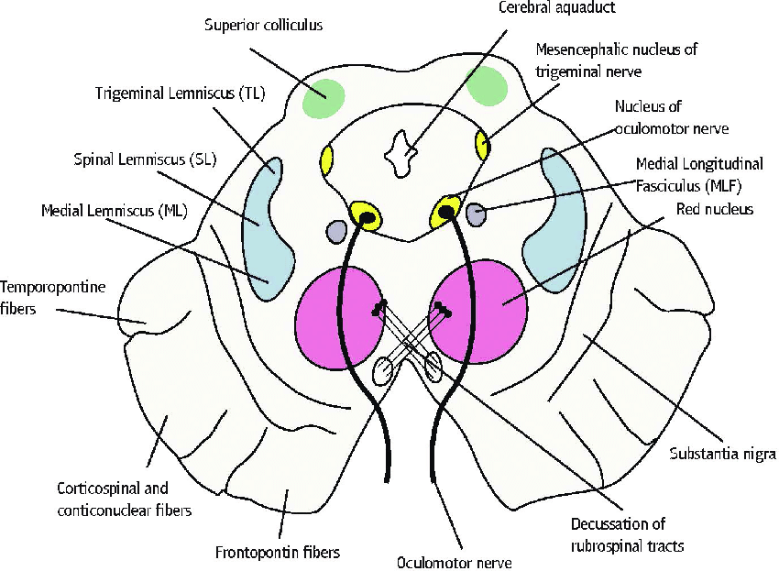
  Tectospinal tract
  Arises from neurons in the superior colliculus of midbrain
  Fibers cross and descends down to end in the upper segments of spinal cord neurons.
  It is concerned with spinovisual reflex
  (reflex neck movements
  in response to visual stimuli)
University of Basrah-College of Medicine-Physiology Department
10

Slide 12
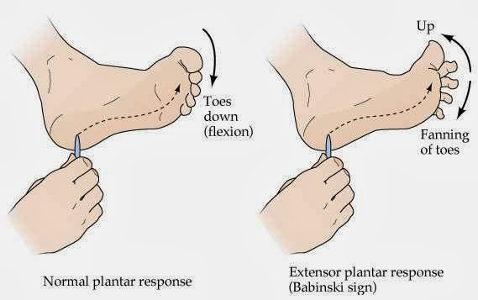
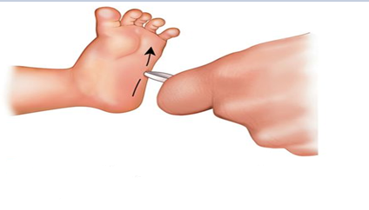
Upper motor neuron sign
Lesion in corticospinal tract, the influence of extrapyramidal tracts on the toes become apparent (dorsiflexion of great toe and fanning out of the other toes)
Normally Babinski sign is positive in infants (pyramidal tract becomes fully developed and myelination is completed only after the child starts walking
University of Basrah-College of Medicine-Physiology Department
11

Slide 13
Recap
1. Reticular formation :It’s a set of interconnected nuclei that are located throughout the brainstem.
Ascending reticular formation
Descending pathway
(Facilitatory area :maintains normal muscle tone, Inhibitory area)
3. Vestibulospinal tract : maintenance of balance, posture, recording sensory information from hairs cells in the labyrinth of the inner ear
  4. Tectospinal tract: reflex neck movements
  in response to visual stimuli
University of Basrah-College of Medicine-Physiology Department
12

Slide 14
Thank You

